Slide 1
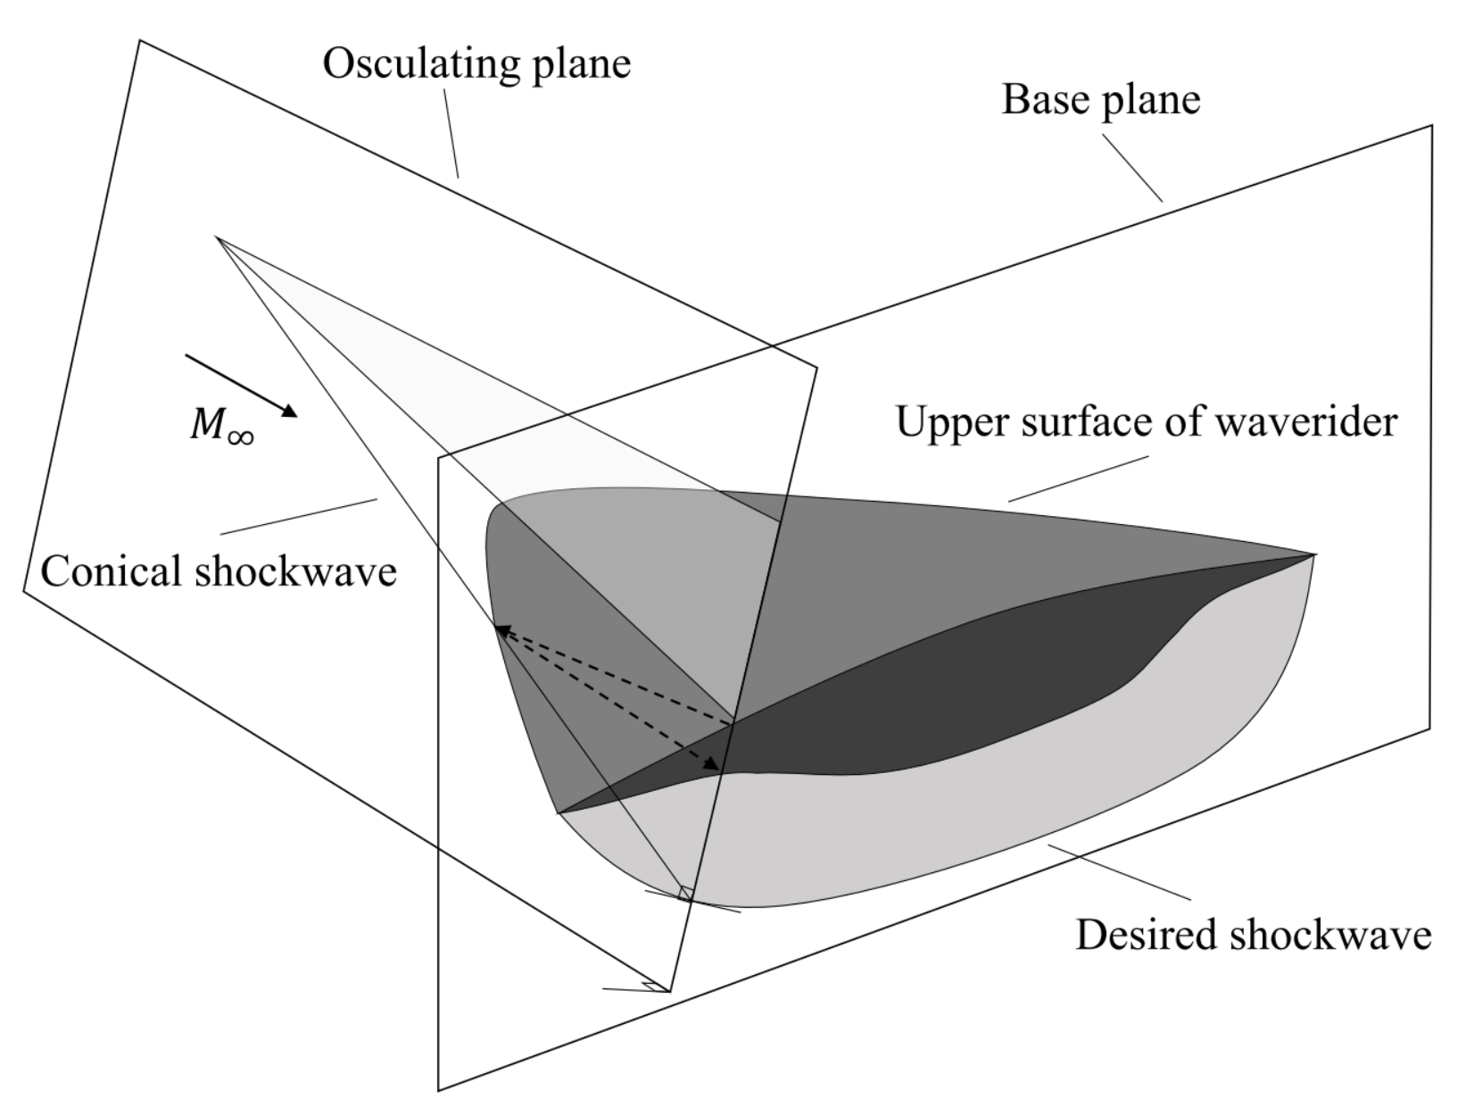
Osculating Plane
Base Plane
C
M∞
β
Conical Shockwave
I
.
B
.
D
n
A
Desired SC

